Slide 1


CMR TECHNICAL CAMPUS UGC AUTONOMOUS Accredited by NBA & NAAC with ‘A’ Grade Approved by AICTE,New Delhi and affiliated to JNTU,Hyderabad Kandlakoya (V), Medchal Road, Hyderabad -501401, Telangana Department of Computer Science and Engineering
MAJOR PROJECT REVIEW -02
STROKE RISK PREDICTION USING MACHINE LEARNING ALGORITHMS.
UNDER THE GUIDENCE OF :
K.SHILPA
ASSISTANT PROFESSOR
PRESENTED BY :
B.SAI BHAVANI (217R5A0510)
N.SANDHYA (207R1A05A4)
V.SURAJ KUMAR (207R1A05B8)

Slide 2
CONTENTS
Abstract
Introduction
Existing system
Disadvantages of existing system
Proposed system
Advantages of proposed system
Hardware and software requirements
Novelty of the project
Architecture
UML Diagrams
Sample code
Results
Conclusion
References
Future scope
Github link

Slide 3
ABSTRACT
The project focuses on leveraging machine learning algorithms to detect stroke warning symptoms early, crucial for prompt intervention and treatment. Through the use of classifiers like J48, ANN, KNN, Random Forest, and Naïve Bayes. This research holds promise for improving stroke detection and intervention, potentially saving lives through early identification of symptoms.
Random Forest stands out as the top performer in predicting strokes with high accuracy. The user-friendly website makes accessing the stroke prediction model easy for medical professionals and patients.

Slide 4
INTRODUCTION
Stroke is a significant health concern worldwide, contributing to high morbidity and mortality rates. Early identification of individuals at risk of stroke is crucial for preventive measures and timely intervention. In recent years, machine learning (ML) techniques have shown promise in predicting stroke risk by leveraging various risk factors and biomarkers
This project aims to develop a stroke risk prediction system using machine learning algorithms. By analyzing a comprehensive set of patient data, medical history, lifestyle factors the proposed system will provide personalized risk assessments for individuals. Such predictive models can aid healthcare professionals in identifying high-risk individuals, enabling targeted interventions and preventive strategies to mitigate the incidence of stroke.

Slide 5
Existing system
In existing system there are no specific risk prediction(SRP) applications which is used to predict
It has less SRP applications which consumes large time management and less prediction which is independent .

Slide 6
Disadvantages of existing system
Data loss
No security
Less efficiency
Less accuracy
Time consuming

Slide 7
Proposed system
we created a prediction model using the random forest algorithm and achieved high accuracy rate.
The model can be integrated with electronic health records to provide a real-time prediction of stroke from lab tests.

Slide 8
Advantages of proposed system
Best accuracy
More efficiency
Security
No data loss
Less time consuming (faster processing)

Slide 9
Requirement specification
Hardware requirements
Software requirements:
System : Pentium IV 2.4GHz.
Floppy Drive : 1.44 Mb.
Monitor : 14’ Clour Monitor.
Mouse : Optical Mouse.
Hard disk : 40GB.
RAM : 512 Mb.
Operating system : Windows 7
Coding Language : Python.
Front-End : Python.
Designing : Html , css, javascript.
Data base : MySQL.

Slide 10
Novelty
This project is unique because it uses a smart mix of technologies to predict stroke risk in a new way. It gathers information from different sources, making it more accurate. The best part is that it can be used in many hospitals and keeps people's information private. They also made it even smarter by using a special technique to improve its settings. In short, it's a clever tool that predicts stroke risk better than what's out there now.

Slide 11
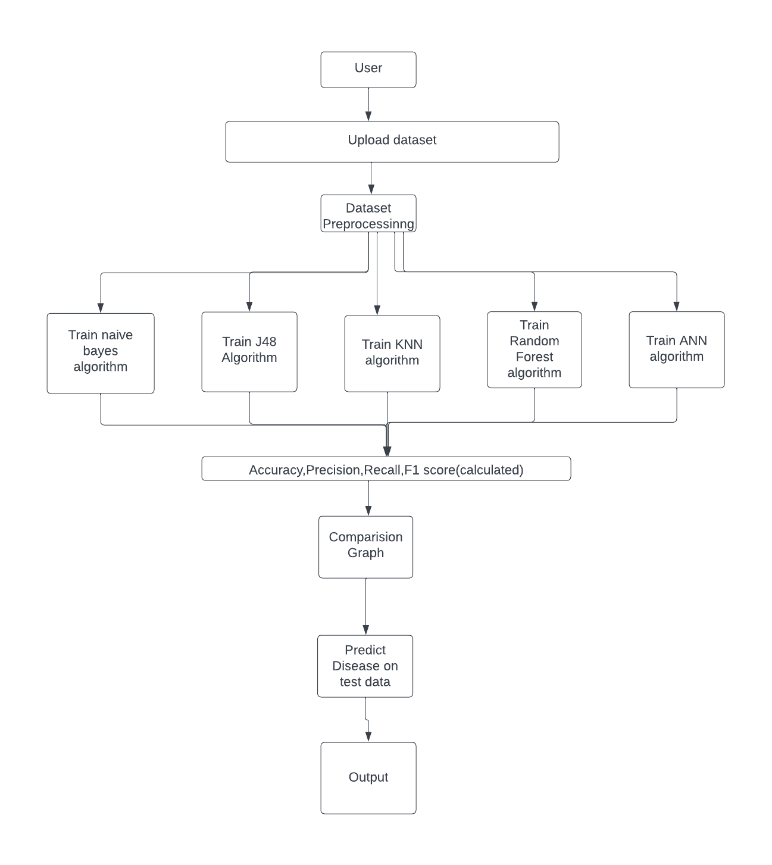
Architecture

Slide 12
UML DIAGRAMS
USE CASE DIGRAM

Slide 13
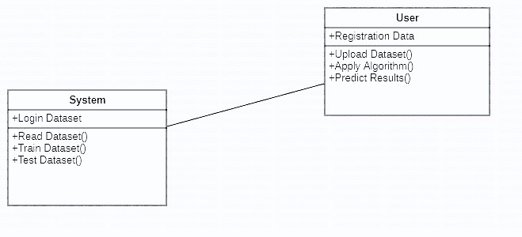
CLASS DIAGRAM

Slide 14
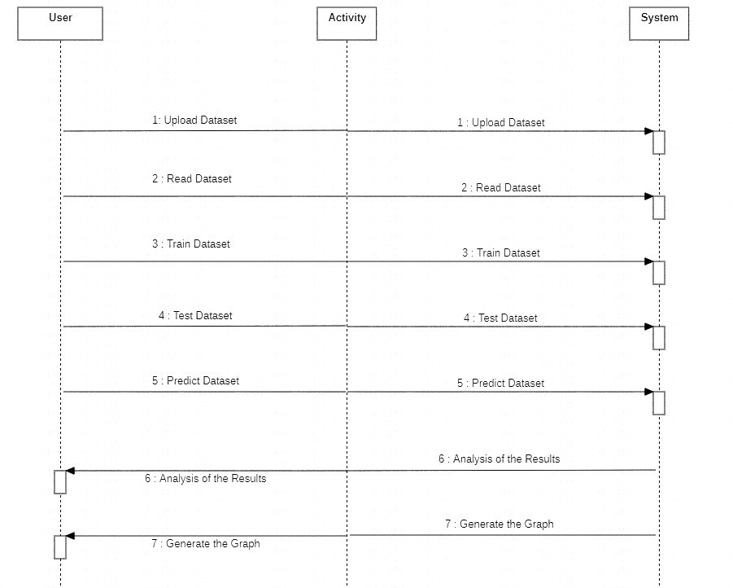
SEQUENCE DIAGRAM

Slide 15
ACTIVITY DIAGRAM

Slide 16
SAMPLE CODE
from tkinter import *
import tkinter
from tkinter import filedialog
import numpy as np
from tkinter.filedialog import askopenfilename
from tkinter import simpledialog
import matplotlib.pyplot as plt
import os
import numpy as np
import pandas as pd
from sklearn.preprocessing import LabelEncoder
from sklearn.model_selection import train_test_split
from sklearn.ensemble import RandomForestClassifier
from sklearn.metrics import accuracy_score
from sklearn.metrics import precision_score
from sklearn.metrics import recall_score
from sklearn.metrics import f1_score
import seaborn as sns

Slide 17
from sklearn.metrics import confusion_matrix
from sklearn.naive_bayes import GaussianNB
from sklearn.tree import DecisionTreeClassifier
from sklearn.neighbors import KNeighborsClassifier
from keras.utils.np_utils import to_categorical
from keras.models import Sequential
from keras.layers import Dense, Dropout, Activation
main = tkinter.Tk()
main.title("STROKE RISK PREDICTION USING MACHINE LEARNING ALGORITHMS")
main.geometry("1000x650")
global filename, le1,le2,le3,le4,le5, dataset, rf
global X, Y
global X_train, X_test, y_train, y_test
accuracy = []
precision = []
recall = []
fscore = []

Slide 18
def loadDataset():
global filename, dataset
text.delete('1.0', END)
filename = filedialog.askopenfilename(initialdir="Dataset")
text.insert(END,str(filename)+" loaded\n\n")
dataset = pd.read_csv(filename)
text.insert(END,str(dataset.head()))
def preprocessDataset():
text.delete('1.0', END)
global X, Y
global X_train, X_test, y_train, y_test
global dataset, le1,le2,le3,le4,le5
le1 = LabelEncoder()
le2 = LabelEncoder()
le3 = LabelEncoder()
le4 = LabelEncoder()
le5 = LabelEncoder()

Slide 19
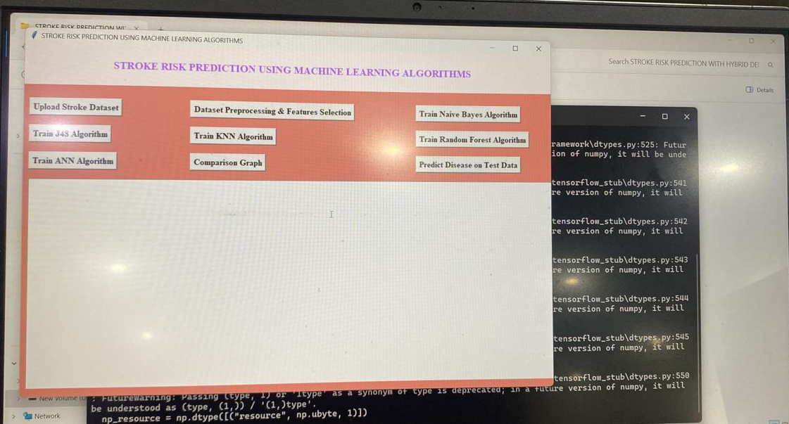
RESULTS

Slide 20
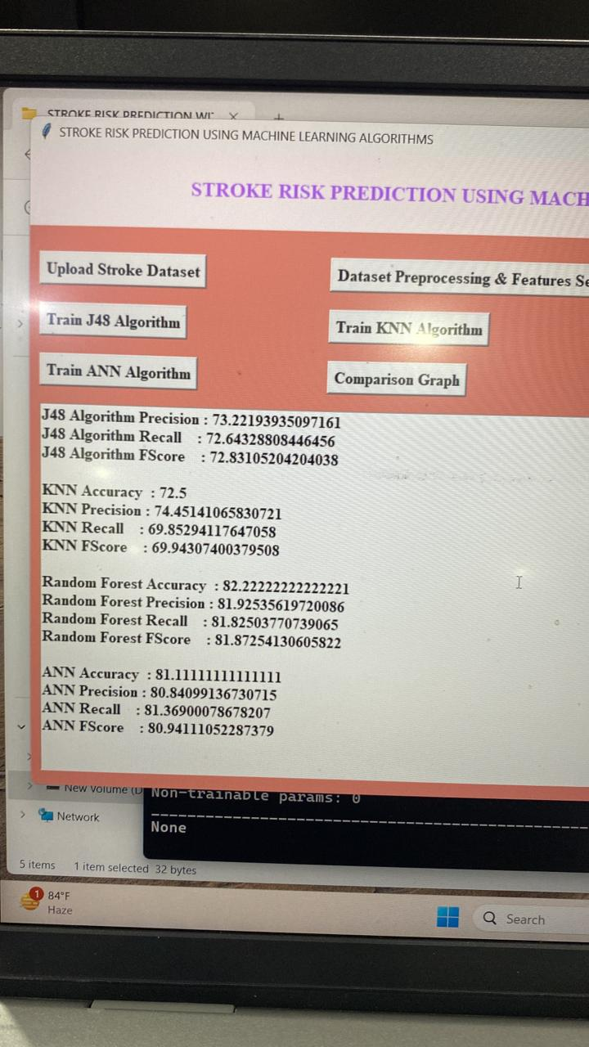

Slide 21
CONCLUSION
A stroke constitutes a threat to a human’s life that should be prevented and/or treated to avoid unexpected complications. Nowadays, with the rapid evolution of AI/ML, the clinical providers, medical experts and decision-makers can exploit the established models to discover the most relevant features (or, else, risk factors) for the stroke occurrence, and can assess the respective probability or risk.

Slide 22
REFERENCES
1]. M. Mahmud and colleagues, "A brain-inspired trust management model to provide security in a cloud-based IoT framework for neuroscience applications," Cognitive Computation, vol. 10, no. 5, pp. 864-873, 2018.
[2]. "Application of deep learning in diagnosingneurological illnesses from magnetic resonance images: a survey on the identification of Alzheimer's disease, Parkinson's disease, and schizophrenia," Brain Informatics, vol. 7, no. 1, 2020, pp. 1–21.
[3]. A. Hussain, M. S. Kaiser, and M. Mahmud, "Deep learning in mining biological data," arXiv preprint arXiv:2003.00108, 2020.
[4]. L. Amini, R. Azarpazhouh, M. T. Farzadfar, S. A. Mousavi, F. Jazaieri, F. Khorvash, R. Norouzi, and N. Toghianfar, "Prediction and control of stroke by data mining," International Journal of Preventive Medicine, vol. 4, no. Suppl 2, May 2013, pp. S245-249.
[5]. R. Ahmed, O. Kaiwartya, and A. James-Taylor.

Slide 23
FUTURE SCOPE
Future research in stroke prediction using machine learning wants to make better computer programs that can tell if someone might have a stroke. They also want to make systems that can warn people early if they're at risk of having a stroke, so they can get help quickly. They're working on making these programs easy for doctors to understand and use in hospitals.All of this should help make strokes less common and less harmfull. All of this should help make strokes less common and less harmful.

Slide 24
GITHUB LINK
https://github.com/SaiBhavani510/stroke-risk-prediction-using-machine-learning-algorithms

Slide 25
thank you

